Slide 1
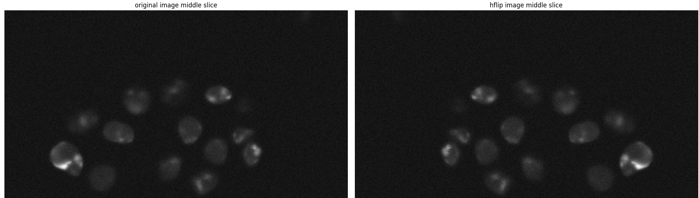
27/6/2024
Testing the augmentations:

Slide 2
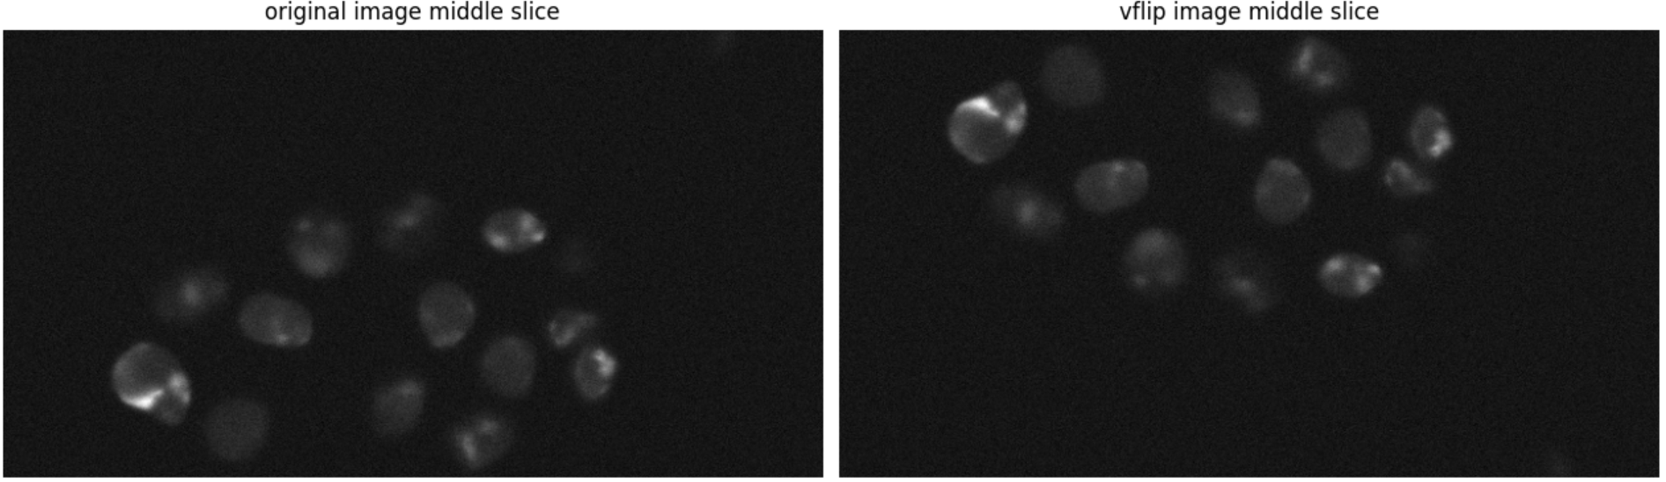
27/6/2024
Testing the augmentations:

Slide 3
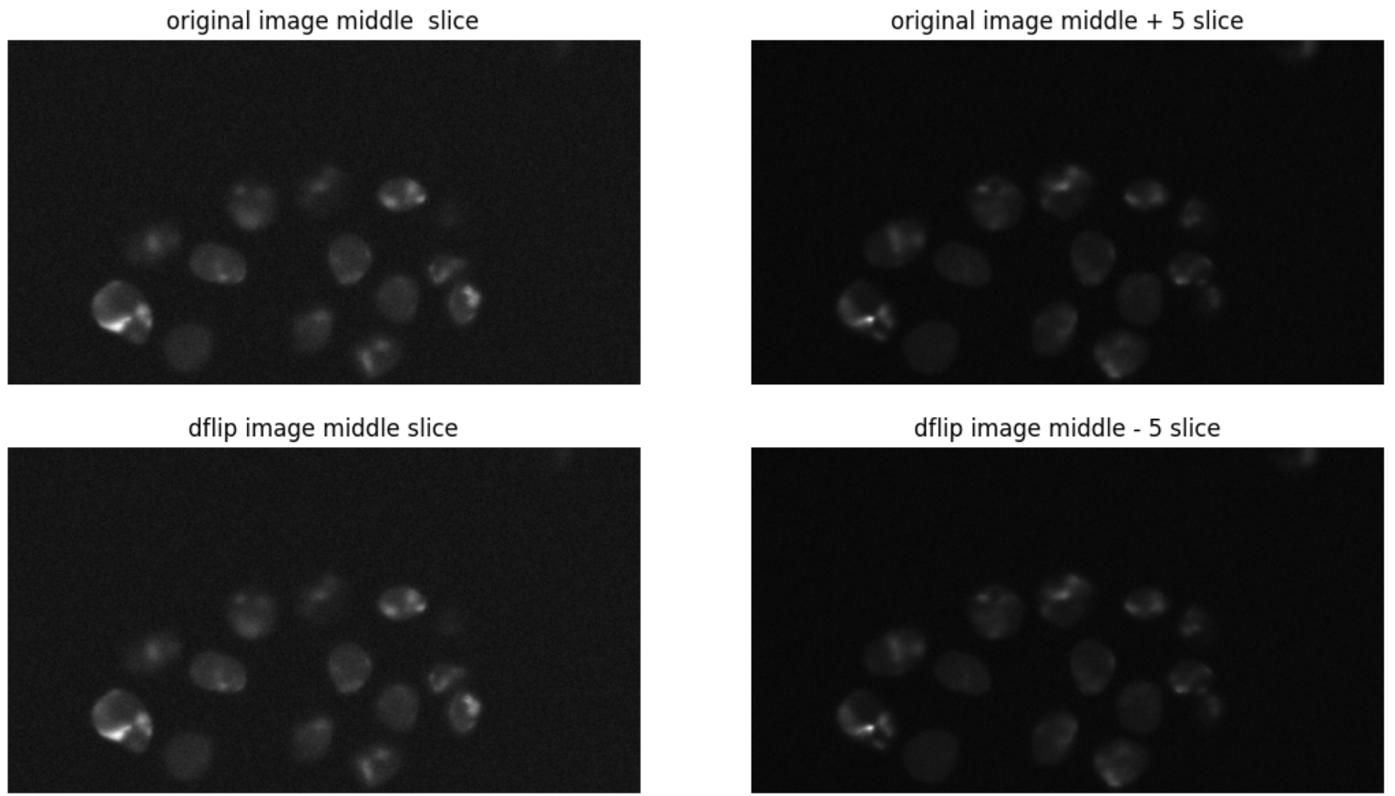
27/6/2024
Testing the augmentations:

Slide 4
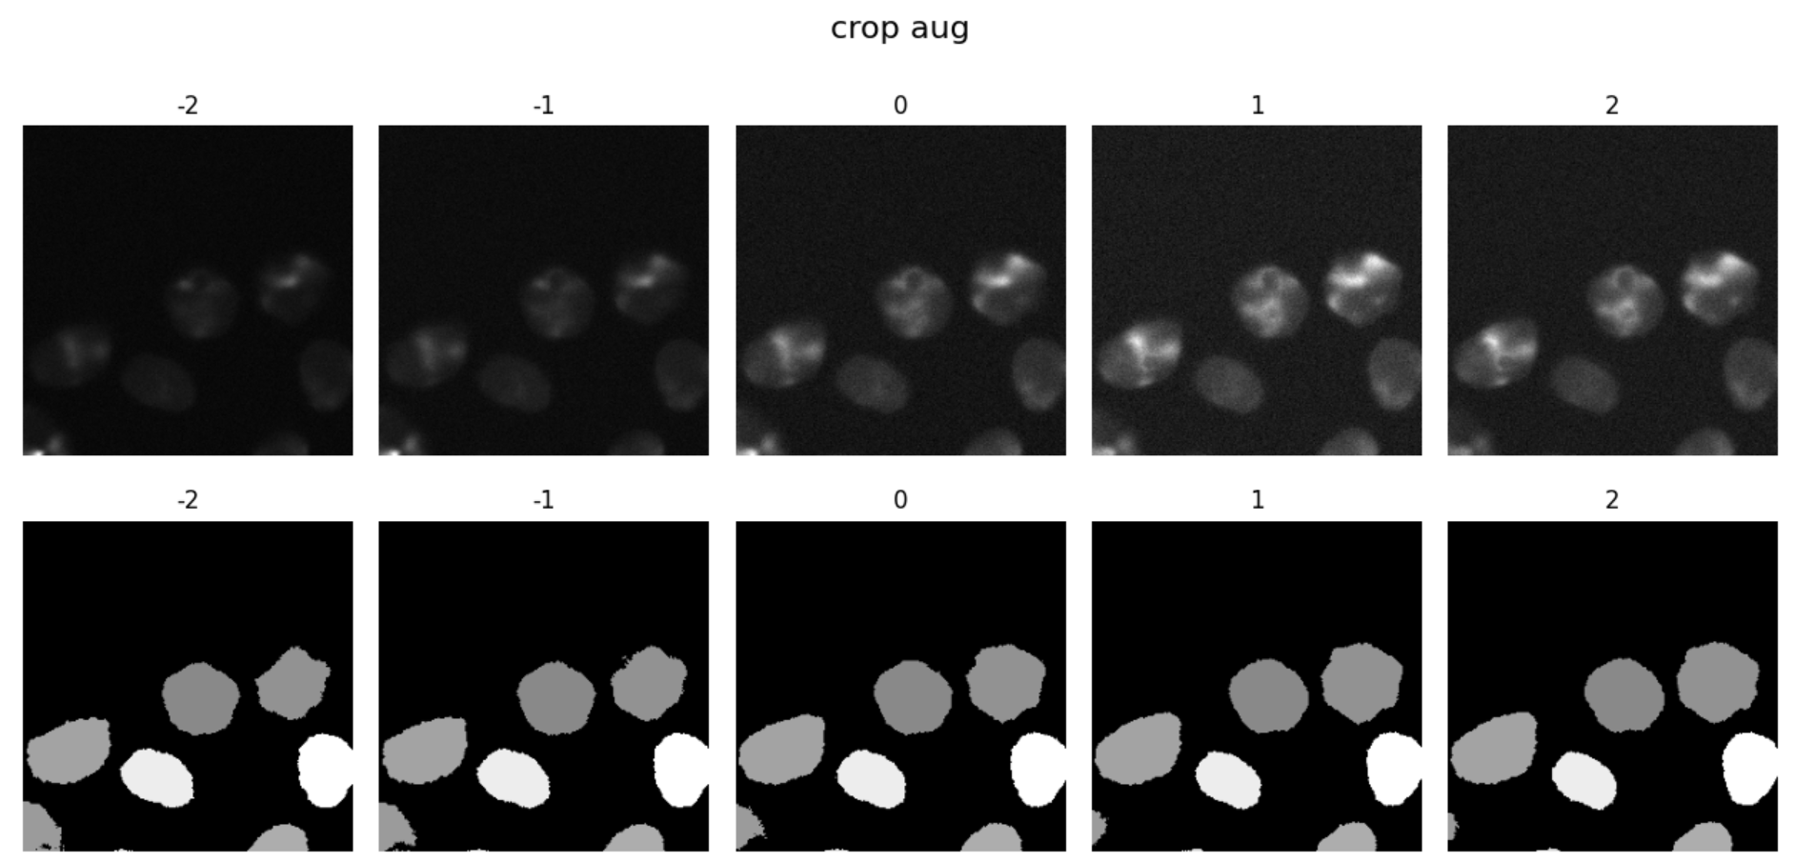
27/6/2024
Testing the augmentations:

Slide 5
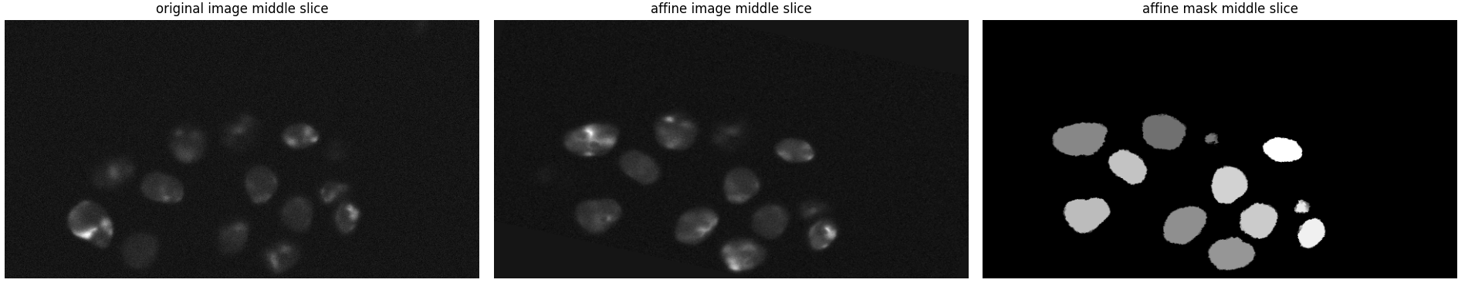
27/6/2024
Testing the augmentations:

Slide 6
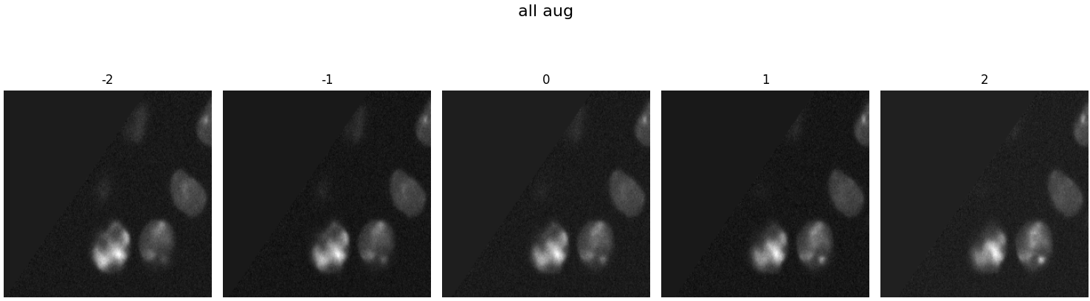
27/6/2024
Testing the augmentations:

